Slide 1
TWO INTERSECTION TRAFFIC CONTROL SYSTEM
TEAM NO 9

Slide 2
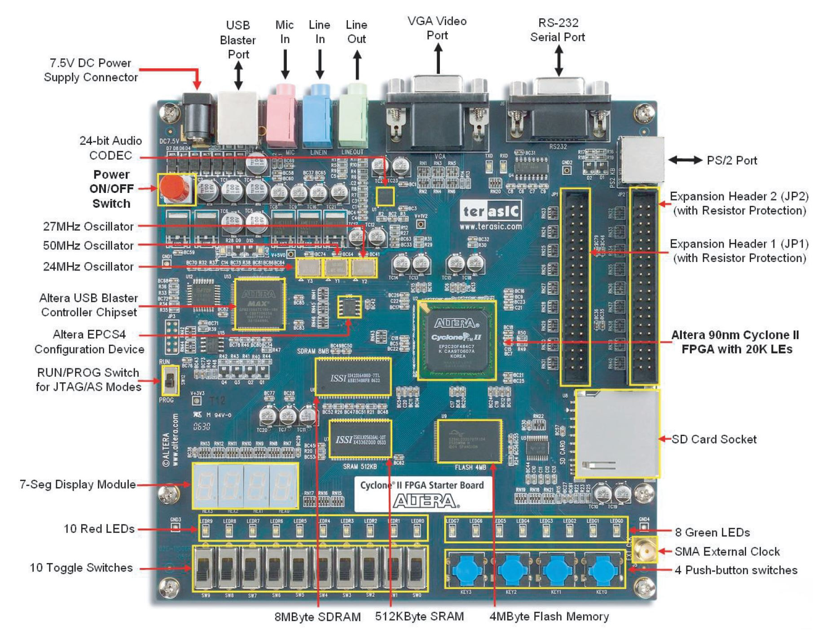
FPGA : Altera Cyclone II EP2C20F484C7N
Software : Quartus II Web Edition

Slide 3
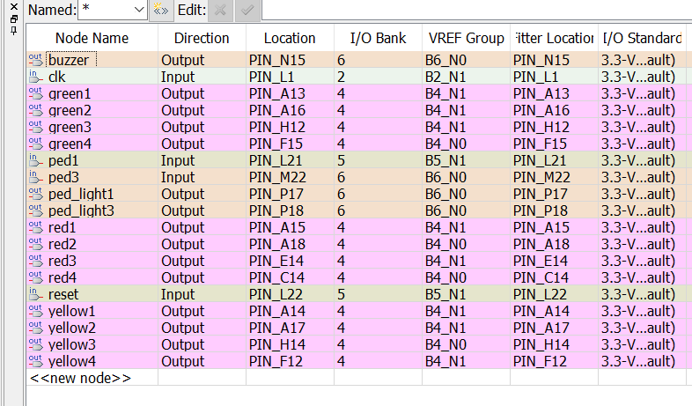
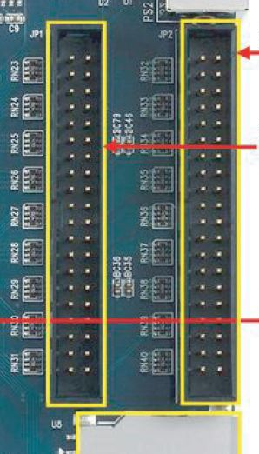
Port List and Pin Configuration

Slide 4
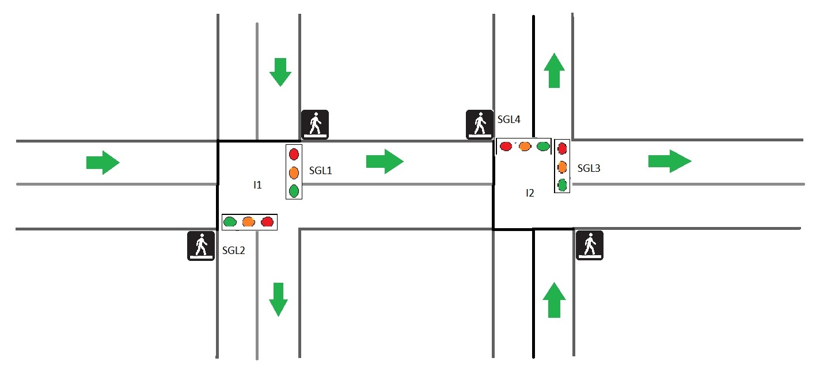
Traffic Signal Framework

Slide 5
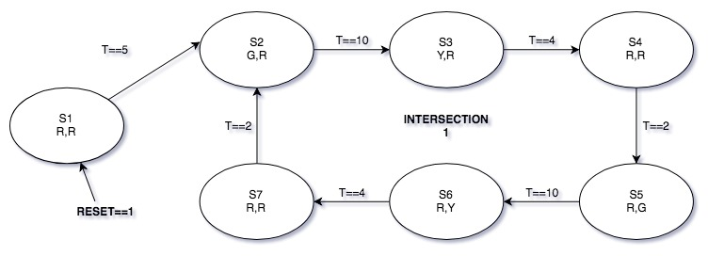
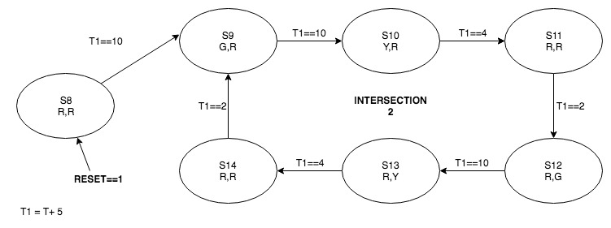
State Diagram

Slide 6
State description
1st state machine for intersection 1 - Red1, Yellow1, Green1 and Red2, Yellow2, Green2.
ST_RESET: Initiates the state machine and resets the machine to it's initial state.
ST_FIRST: Every signal is set to red in this state.
ST_SECOND: 1st signal turns green1, 2nd is still red2.
ST_THIRD: 1st signal turns yellow1 after 10 seconds, 2nd is still red2.
ST_FOURTH: 1st signal turns red1 after 4 seconds while 2nd is still red2.
ST_FIFTH: 2nd turns green2 after 2 seconds while 1st stays red1.
ST_SIXTH: 2nd turns yellow2 after 10 seconds, while 1st stays red1.
ST_SEVENTH: 1st and 2nd signals are turned red in this state.

Slide 7
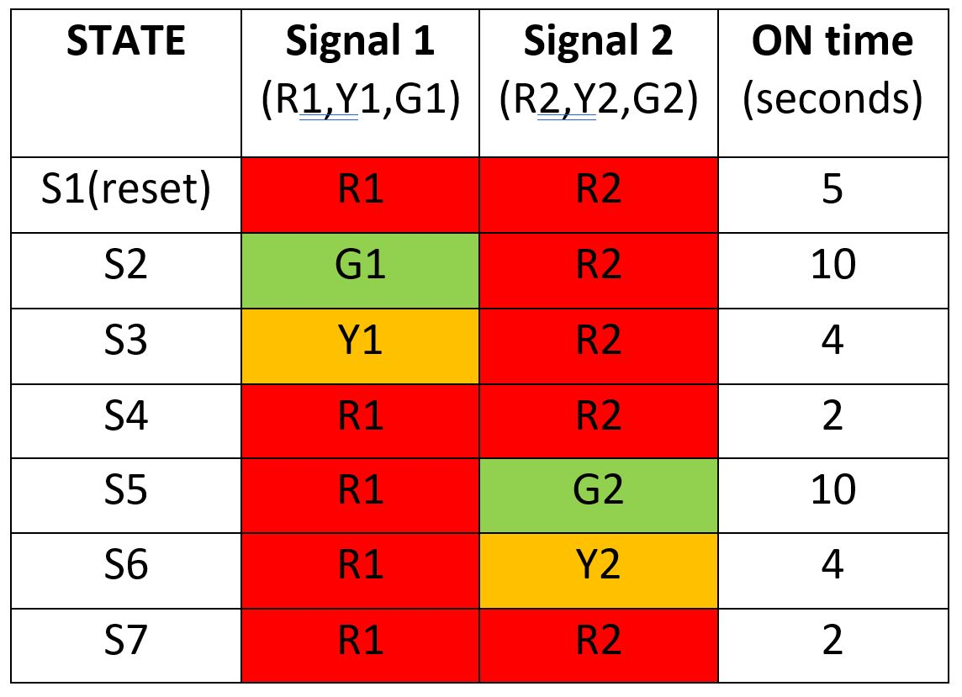
State Table for Intersection 1
Same state table has been replicated for the Intersection 2 with a 5 second delay from Intersection 1

Slide 8
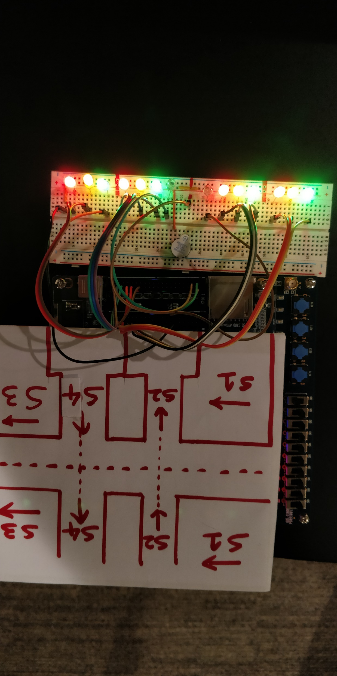
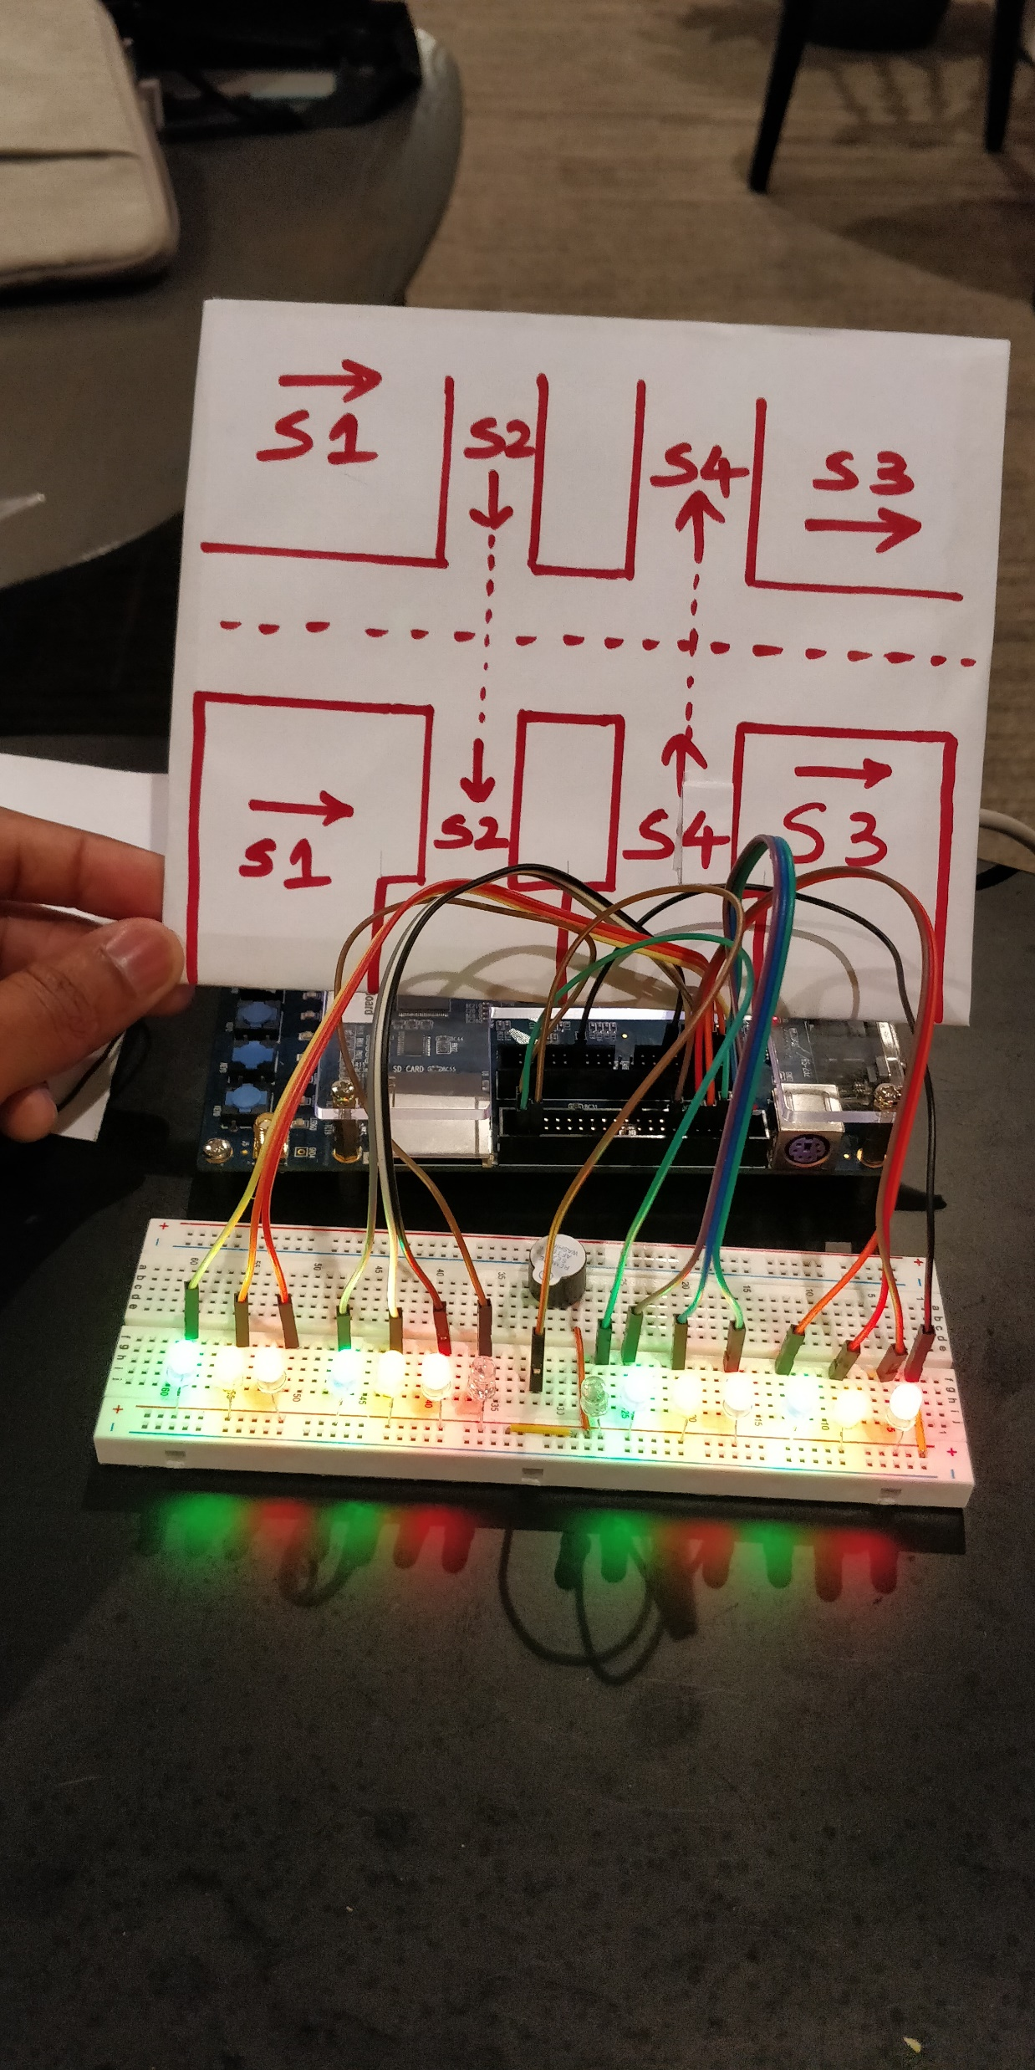

Slide 9
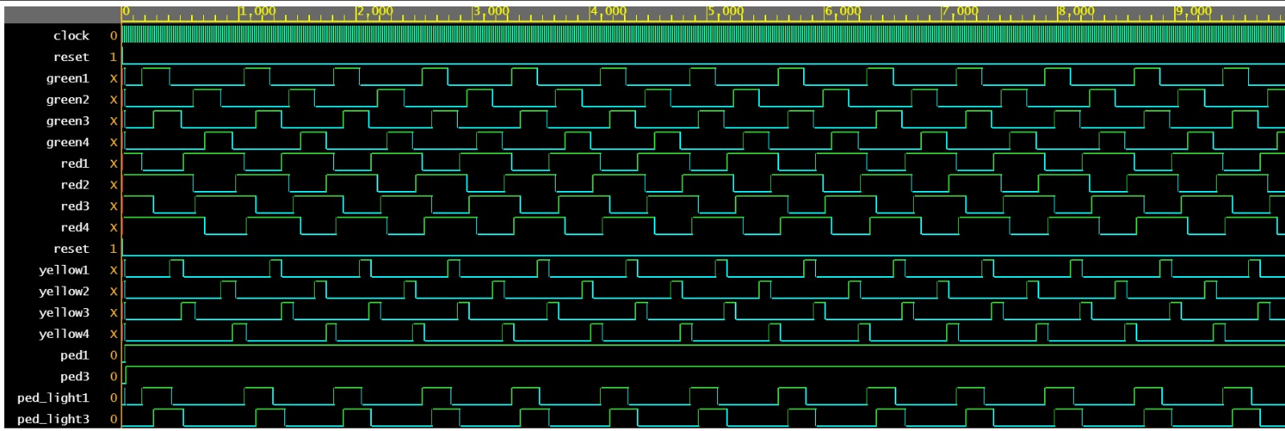
Timing Diagram

